Slide 1
Dumping
Dr. Vittorio Corso
U.F.. Chirurgia bariatrica
Ospedale Privato Accreditato
Villa Maria rimini

Slide 2
Dumping syndrome, a frequently described phenomenon after bariatric surgery, arises from the rapid emptying or “dumping” of undigested gastric contents into the small intestine.

Slide 3
In general, we can state that early dumping occurs on average in 15.7% of patients, within six months after bariatric surgery . Late dumping can reach up to 25%
Bariatric surgery is the leading cause of the dumping syndrome, with a prevalence of up to 76% after Roux-en-Y Gastric Bypass (RYGB)
An important note is that the prevalence of dumping greatly varies depending on the terminology and diagnostic method used. On average, studies using the Sigstad score obtained higher percentages of dumping compared to physiological testing or alternative question- naires. For example, incidence rates of up to 76% have been documented after RYGB based on the Sigstad questionnaire

Slide 4
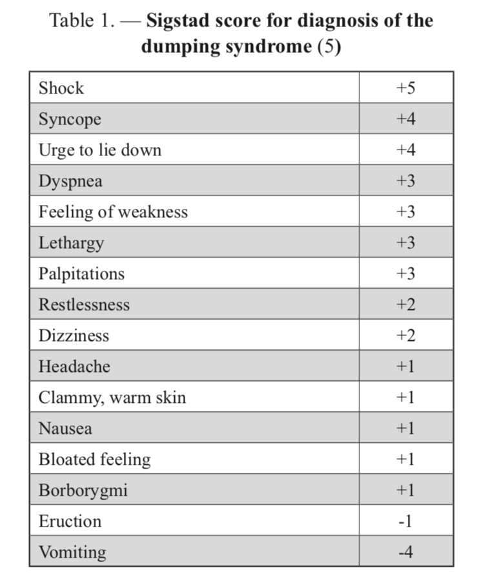
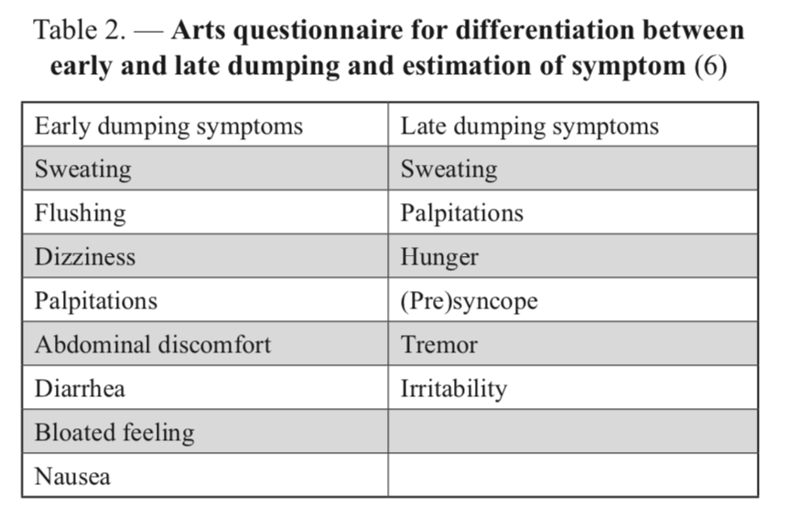

Slide 6
Establishing an unambiguous diagnostic tool to detect the dumping syndrome remains a difficulty. The occurrence of typical dumping symptoms related to food intake after bariatric surgery, appears to be the best method to diagnose the condition, whereas the OGTT can be regarded as supporting evidence.

Slide 7
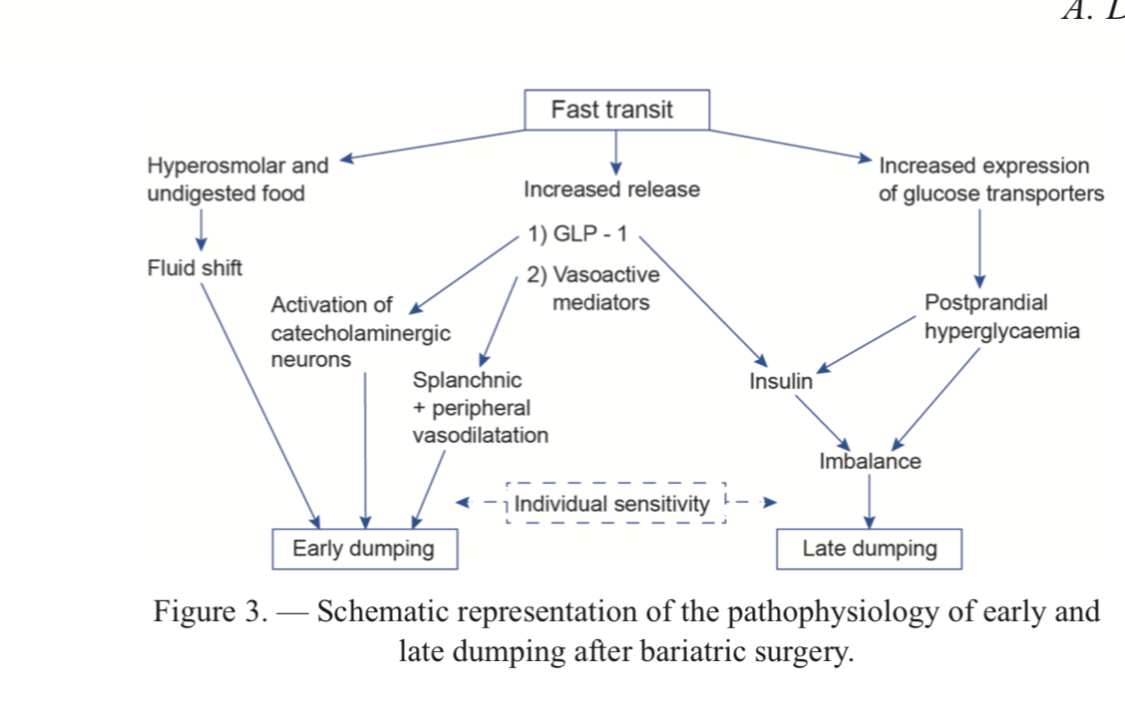

Slide 8
When the pylorus is still intact and normal vagal innervation is lost, this can result in pyloric relaxation and loss of duodenal feedback inhibition, leading to an accelerated transit time
The rapid emptying of the stomach would result in largely undigested and hyperosmolar food reaching the small intestine, resulting in a fluid shift …the intravascular compartment to the lumen, causing abdominal distention and symptoms of early dumping.

Slide 9
GLP-1 levels, norepinephrine release and increase in heart rate are significantly increased in patients after RYGB compared to asymptomatic individuals and correlated with symptoms of early dumping
early gastrointestinal symptoms disappear in patients after RYGB when glucose is administered through slow intestinal infusion and GLP-1 release is reduced to normal values
These data suggest a pathogenetic role for GLP- 1 in both the early and late dumping syndrome. GLP-1 antagonists are therefore already under development as a treatment option in the dumping syndrome.

Slide 10
Postprandial hyperglycemia after bariatric surgery can induce chronic stress on pancreatic tissue and is postulated to induce increased proliferation of beta cells, also known as nesidioblastosis
The presence of late dumping is most likely a spectrum resulting from augmented glucose absorption, a certain degree of beta and alpha cell dysregulation, a reduced peripheral insulin resistance after weight loss and an important variability in individual sensibility to hypoglycemia.
The fast transit leads to a shorter contact time of the nutrients with the intestinal surface, eventually leading to initial carbohydrate malabsorption which would then result in an increased expression of glucose transporters

Slide 11
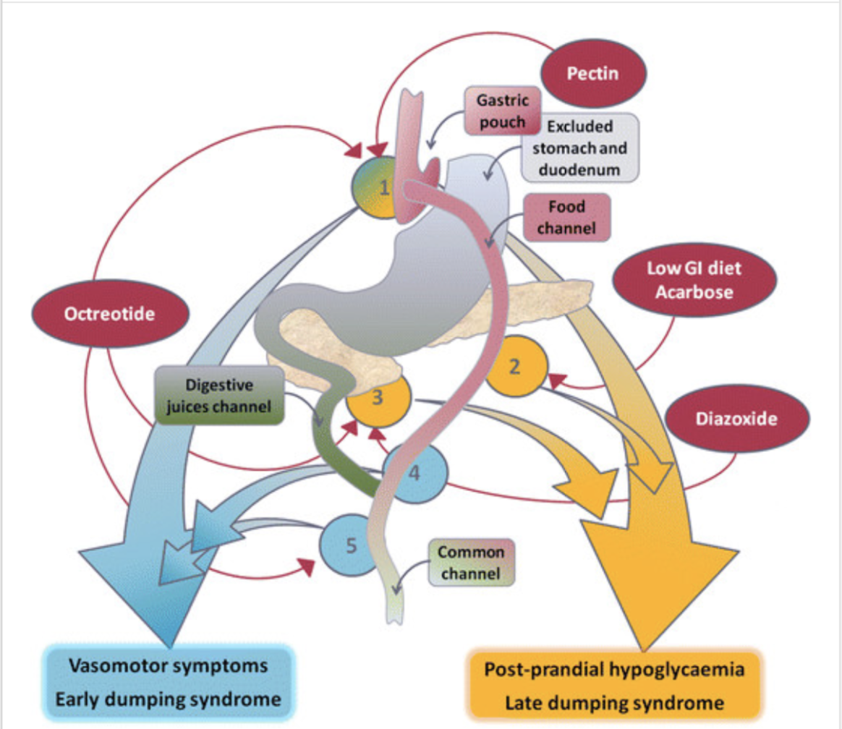

Slide 12
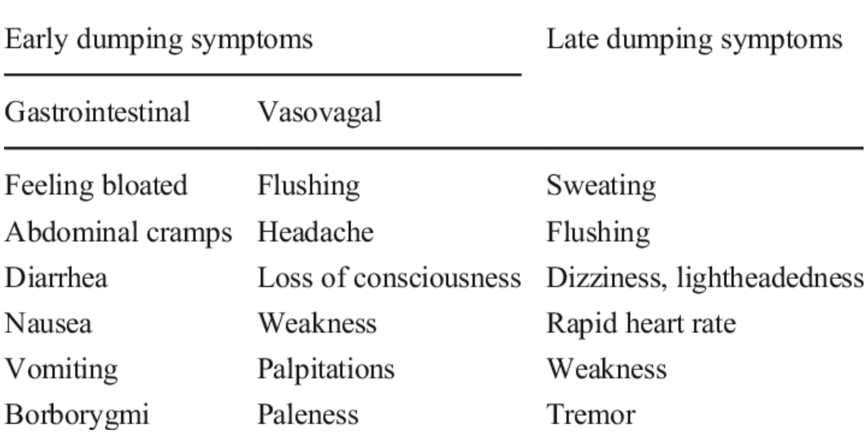

Slide 13
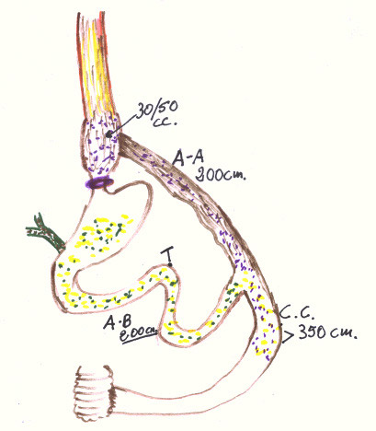
Vantaggi RYGBP VL funzionale a stomaco esplorabile sec. Lesti-Zappa
When the pylorus is still intact and normal vagal innervation is lost, this can result in pyloric relaxation and loss of duodenal feedback inhibition, leading to an accelerated transit time

Slide 14
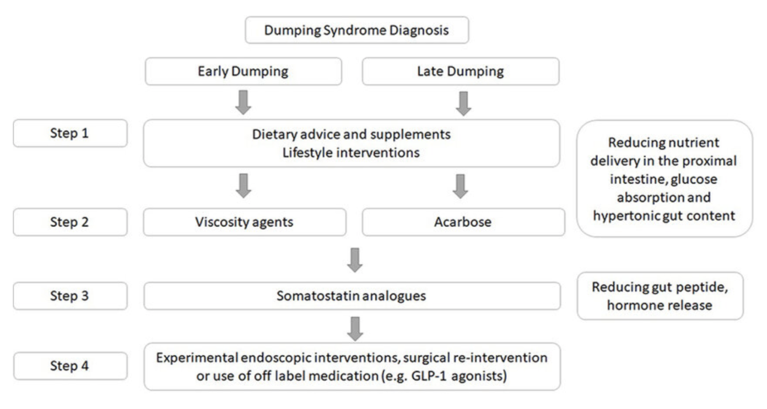

Slide 15
Dietary modification is the initial treatment approach where patients are advised to reduce the amount of food ingested at each meal, to postpone fluid intake until at least 30 min after meals and to eliminate rap- idly absorbable carbohydrates, which are present in all sweet foods and drinks, for instance. Instead, patients are advised to eat a diet consisting of foods that are high in fibre and rich in protein; consumption of fruit and vegetables is encouraged, whereas alcoholic beverages are better avoided¹. Case series in adults and children argue in favour of the benefit of dietary intervention, but the focus of these studies is on late dumping syndrome (hypoglycaemia)^{1,20,92–96}. Patients should also eat slowly and chew well¹. Controlled data showing benefit from protein-rich foods or delaying fluid intake are not avail- able in the literature. Education about the glycaemic index of different foods might also be helpful for patients with dumping syndrome. In addition, patients can be advised to lie down for 30 min after meals to delay gastric empty- ing and reduce the symptoms of hypovolaemia; however, evidence for this approach is lacking^{8,96–99}.

Slide 16
A number of studies have evaluated the use of supplements that increase food viscosity, such as guar gum, pectin and glucomannan,
Acarbose is an alpha-glycosidase inhibitor that slows the release of monoglycerides from nutritional carbo- hydrates.

Slide 17
Somatostatin analogues are able to slow the rate of gastric emptying, slow small bowel transit, inhibit the release of gastrointestinal hormones, inhibit insulin secretion and inhibit postprandial vasodilation; these analogues are therefore of potential benefit for both early and late dumping syndromes
Indeed, long-acting octreotide (intramuscularly) might offer the potential advantage of less frequent injections that are more convenient for the patient and might reduce injection aversion, which was often reported with short-acting octreotide injections (subcutaneously)

Slide 18
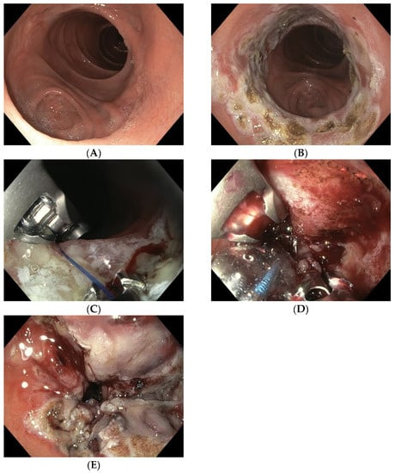

Slide 19
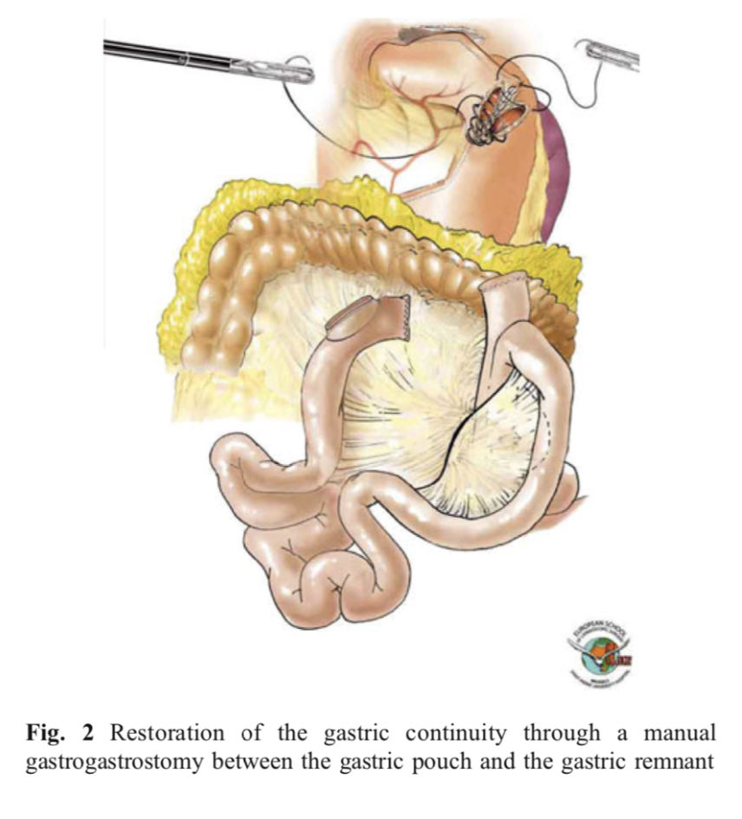
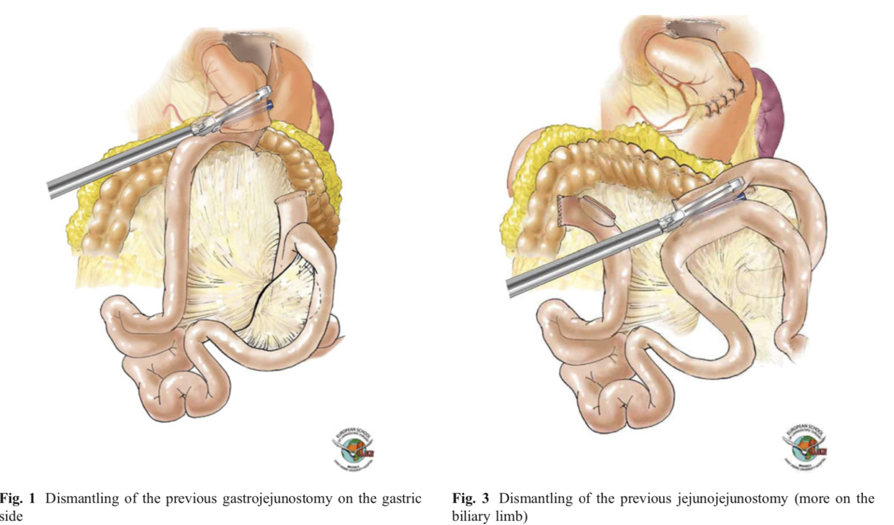
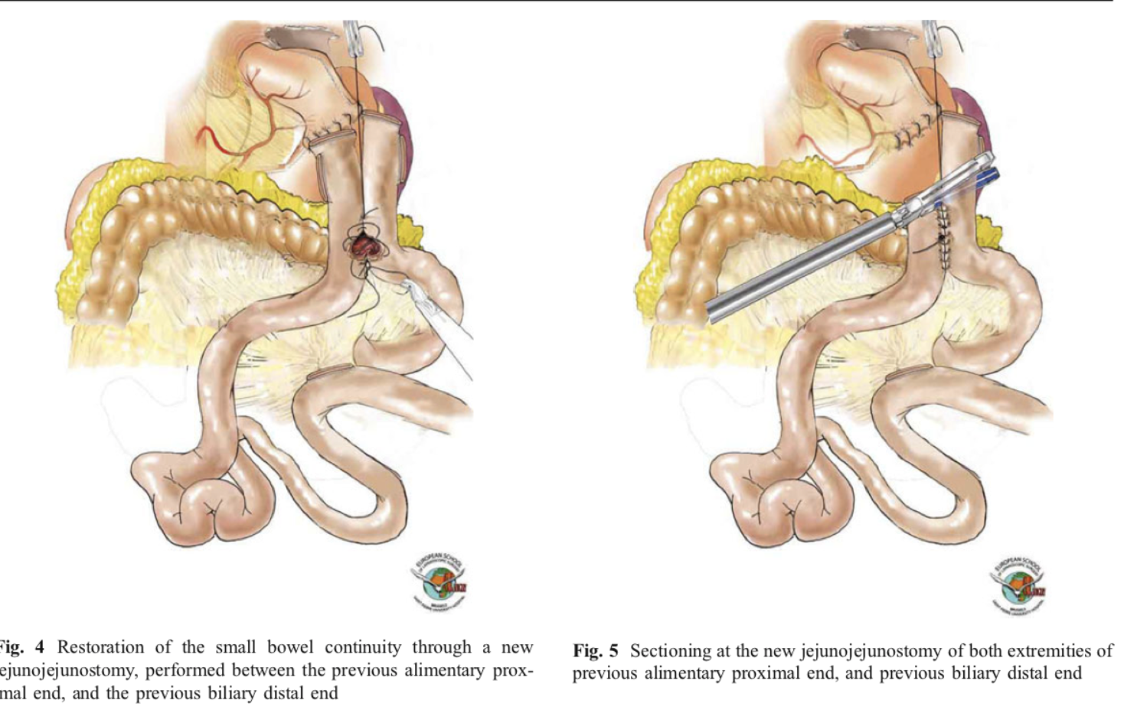

Slide 22
Grazie

